Slide 1
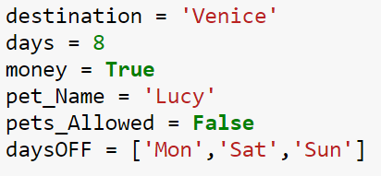
Variable types

Slide 2


Slide 3



Can’t perform arithmetic operations

Slide 4
Changing types
int( )
a = 4.5
b = int(a)
________
b = 4
float( )
a = 5
b = float(a)
________
b = 5.0
str( )
a = 5
b = str(a)
________
b = “5”
a = “Hi!”
b = int(a)
________
b = error
a = “Car”
b = float(a)
________
b =
a = “5b7”
b = str(a)
________
b =

Slide 5
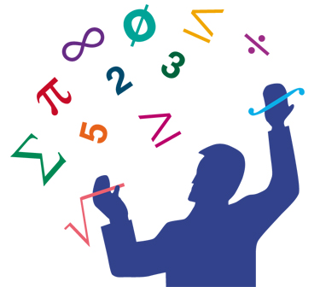
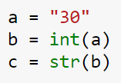


string
integer
string
integer
string

Slide 6
If Statements
Making decisions

Slide 7
Python Comparisons Operator
== | equal
!= | not equal
> | greater than
< | smaller than
>= | greater than or equal to
<= | smaller than or equal to

Slide 8
3 < 2
5 > 3
3 = 4
3 == 4
1 >= 1
5 != 7
var =
b =

Slide 9

Try the following and take a look at the output
Assign
a | 3
4
Check

Slide 10
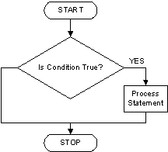

Slide 11
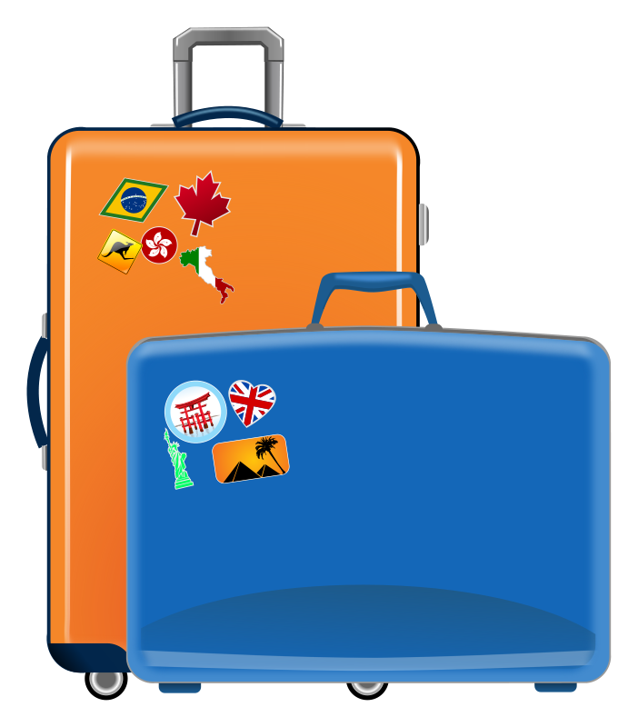
Imagine you are writing a program for an airport. Your program should ask the user how much their suitcase weights and tell the user if the suitcase is too heavy or good to go. 50 pounds is the maximum weight for a checked bag.
Program: How many pounds does your suitcase weight?
You: 70
Program: There is a $25 charge for luggage that
heavy.
Thank you for your business.
______________________________________________
Program: How many pounds does your suitcase weight?
You: 40
Program: Thank you for your business.

Slide 12
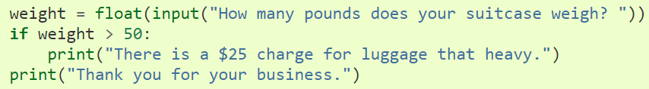

Slide 13
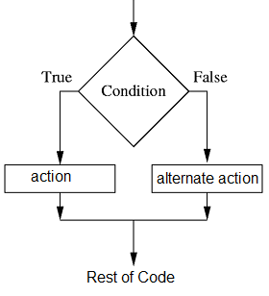

Slide 14
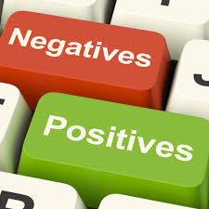

Write a program that given a number, it returns if the number is positive or negative.

Slide 15
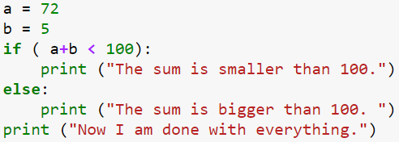
Write a program that given 2 numbers, it returns if their sum is bigger than 20.

Slide 16

You are writing a program for the Pokemon Go users and you want to check if they are old enough to accept the Terms and Conditions. If they are younger than 13, a parent needs to accept for them.
Program: How old are you?
User: 12
Program: Your parents need to accept the terms and conditions.
Thank you!
_____________________________________________
Program: How old are you?
You: 13
Program: Thank you!

Slide 17
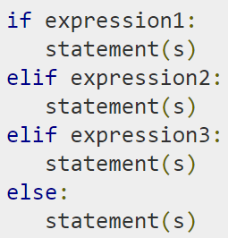
What if we have more than one condition?

Slide 18
If the weight of the bag is bigger than 50 pounds, inform the user that there is a $25 charge.
If the weight of the bag is smaller or equal to 50 pounds, inform the user that there is no charge.
Program: How many pounds does your suitcase weight?
You: 70
Program: There is a $25 charge for luggage that
heavy.
Thank you for your business.
______________________________________________
Program: How many pounds does your suitcase weight?
You: 50
Program: There is no extra charge.
Program: Thank you for your business.

Slide 19
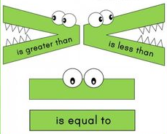
Write a program that given 3 numbers, it returns if their sum is smaller than 50, equal to 50 or bigger than 50.

Slide 20

goo.gl/forms/g3vv2hFcA67w16Vt2

Slide 21
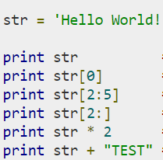
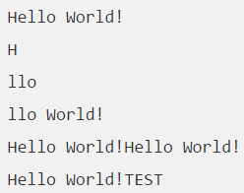
Subset of Strings ( [ ] and [ : ] )
Concatenation / Union ( + )
Repetition ( * )

Slide 22
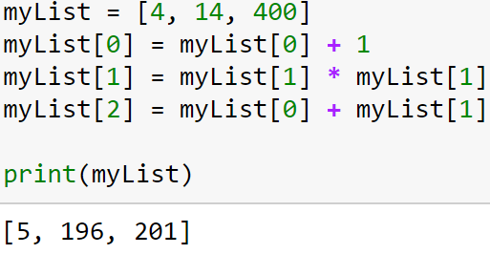
Now try to do the same thing, but instead of putting your numbers in a list, put them in a tuple. Can you see the difference?

Slide 23
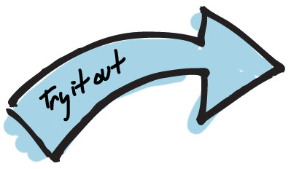

Write a program that asks the user for a string and it prints out what the first letter of the word is.

Slide 24
2. Write a program that asks the user for a string and it prints out what the third letter of the word is.

Slide 25

a = len(string_name)
3. Write a program that asks the user for a string and it prints out the last letter of the string.

Slide 26
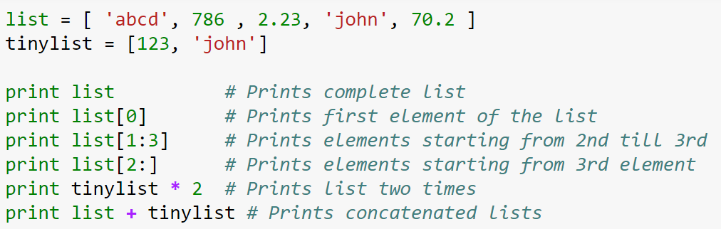
Python Lists [ ]
Versatile (able to adapt / change).
The elements and size of the list can be changed.
The items in a list can be of different data types.

Slide 27
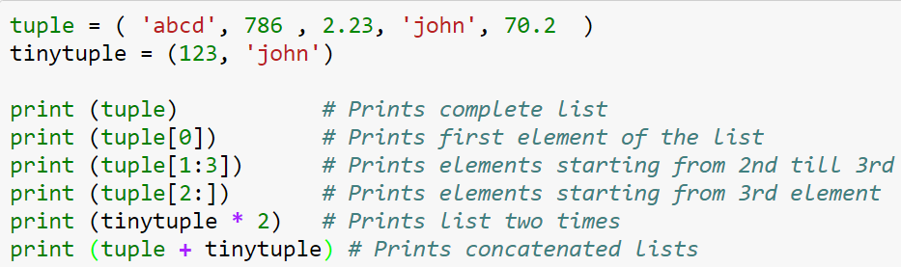
Tuples ( )
Lists that cannot be updated.
They are read - only.

Slide 28
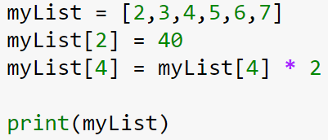

Modifying Lists
Your Turn!
Create a list of 3 numbers.
- change the value of the first by adding 1 to it.
- change the value of the second element by multiplying it to itself.
- change the value of the third element with the sum of the first two new elements of the list.

